Slide 1
RoboCat Demo
By: Joel and John Huff, and Eddie Kerbler

Slide 2
Face / Emotion Recognition
Demo: https://www.youtube.com/watch?v=4DYLBbERejQ
Red dot showing coordinates of center of face on screen, allowing app to drive neck servos to center face on screen, or “Stare”
Green Circle at the top showing “Happy” emotion, allowing app to adjust cats overall “Happiness” and show corresponding face to go with it’s “Mood”

Slide 3
Cat Face/Passcode Screen
Demo: Emulator…
Currently place holder for image of cats face.
A Cat class running allowing handling of emotion and openCV facial recognition.
Methods to adjust “Happiness” and change face when applicable.
Handling of Konami Code “Passcode” to enter the menu for servo control and other settings.

Slide 4
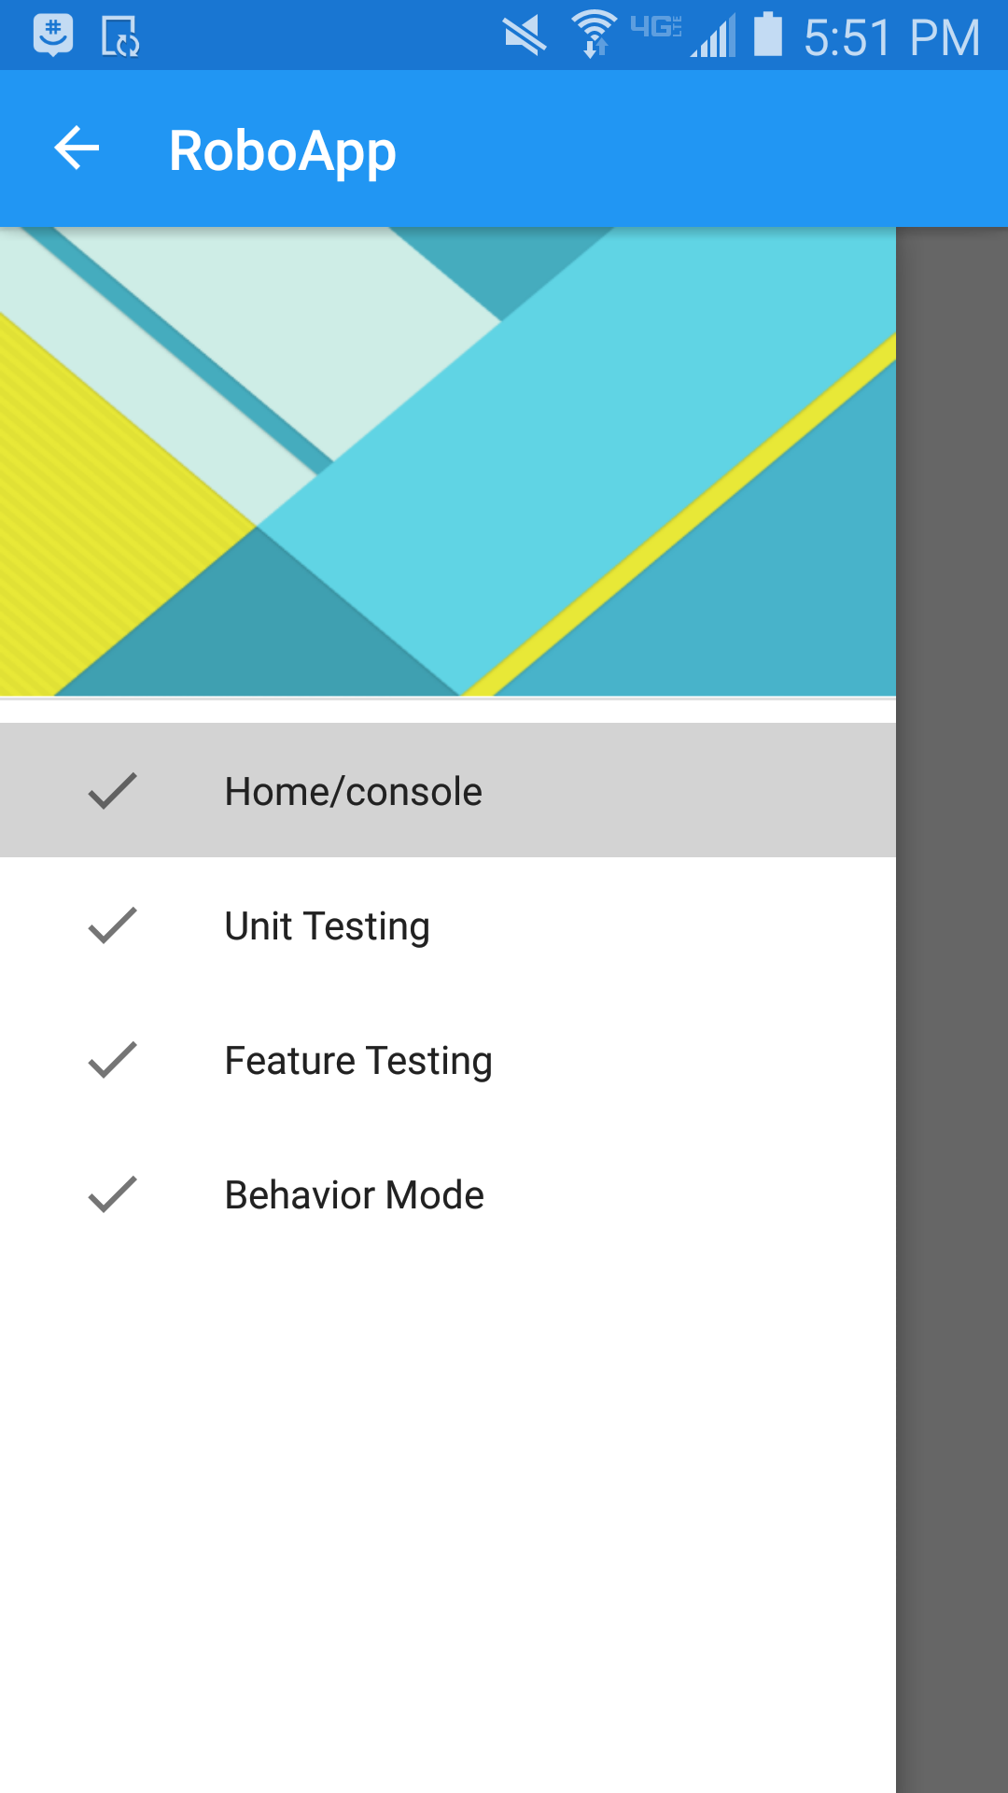
Menu/Servo Control
Screenshot:
Menu to handle settings and Servo Control
Accurate way to control individual servos on the cat
Console to help with debugging or errors with the cat

